Slide 1
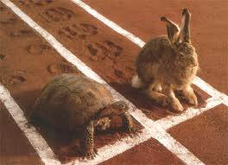
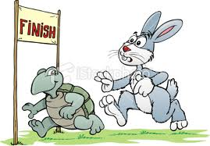
HOW FAST or SLOW?
A Presentation about
TEMPO in MUSIC
(tempi is the plural form)
By John F. Morgan

Slide 2
tempo
the speed of the beat. usually given in bpm's or generalized with Italian terms (tempi is plural)

Slide 3
beat
the steady, background pulse of the music. Also, how to mix eggs

Slide 4
foot
the part of the body most often used by musicians to mark tempo

Slide 5
hand
the part of the body most used by conductors to indicate tempo

Slide 6
bpm
beats per minute, abbreviated
If the composer is specific about the expected performance tempo, she (he) lists the bpm’s of a particular rhythm: i.e. quarter = 112 above.

Slide 7
grave
slowly and solemnly
(20–40 bpm)

Slide 8
largo
slowly and in a stately manner
Literally “broadly”
(40–60 bpm)

Slide 9
lento
very slowly
(40–60 bpm)

Slide 10
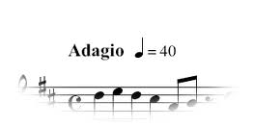
adagio
(literally, "at ease")
very slowly, at a leisurely pace
(66–76 bpm)

Slide 11
andante
smoothly, not too fast, not too slow; walking speed
(76–108 bpm)

Slide 12
andantino
at a gentle speed, a little faster than andante

Slide 13
moderato
at a moderate speed
(108–120 bpm)

Slide 14
allegretto
fairly brightly and in a lively manner; faster than moderato, not quite so fast as allegro

Slide 15
allegro
at a lively pace, brightly (fast)
(112–124 bpm)

Slide 16
vivace
full of life, probably faster than allegro
(≈140 bpm)

Slide 17
presto
quickly, at a dashing pace
(168–200 bpm)

Slide 18
prestissimo
very quickly
(more than 200bpm)

Slide 19
Other words attached to tempi markings: (Advanced students)
molto – a lot
tranquillo – peacefully
espressivo – with much expression
non troppo – without rushing
con fuoco – with fire
poco agitato –a little quicker, with agitation and excitement

Slide 20
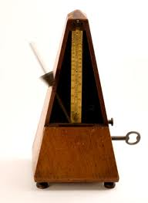
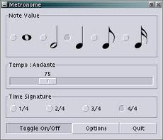
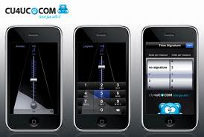
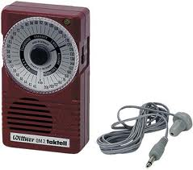
Metronome
A machine that marks tempo

Slide 21
movement
a section of a symphonic work that is named by the tempo marking, as in the Allegro _______or the Andante __________

Slide 22
ritardando
a temporary and gradual slowing down, lingering. Often used to reduce the pace at the end of the piece

Slide 23
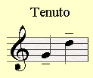
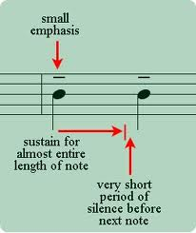
tenuto
holding or lingering of a single note

Slide 24
allargando
becoming slower and broader, generally louder as well

Slide 25
accelerando
gradually becoming faster

Slide 26
stringendo
a temporary quickening of the pace

Slide 27
a tempo
Pronounced “Ah Tempo” -back to the original speed after some change of pace. Also called Tempo I (tempo “primo”)

Slide 28
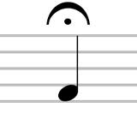
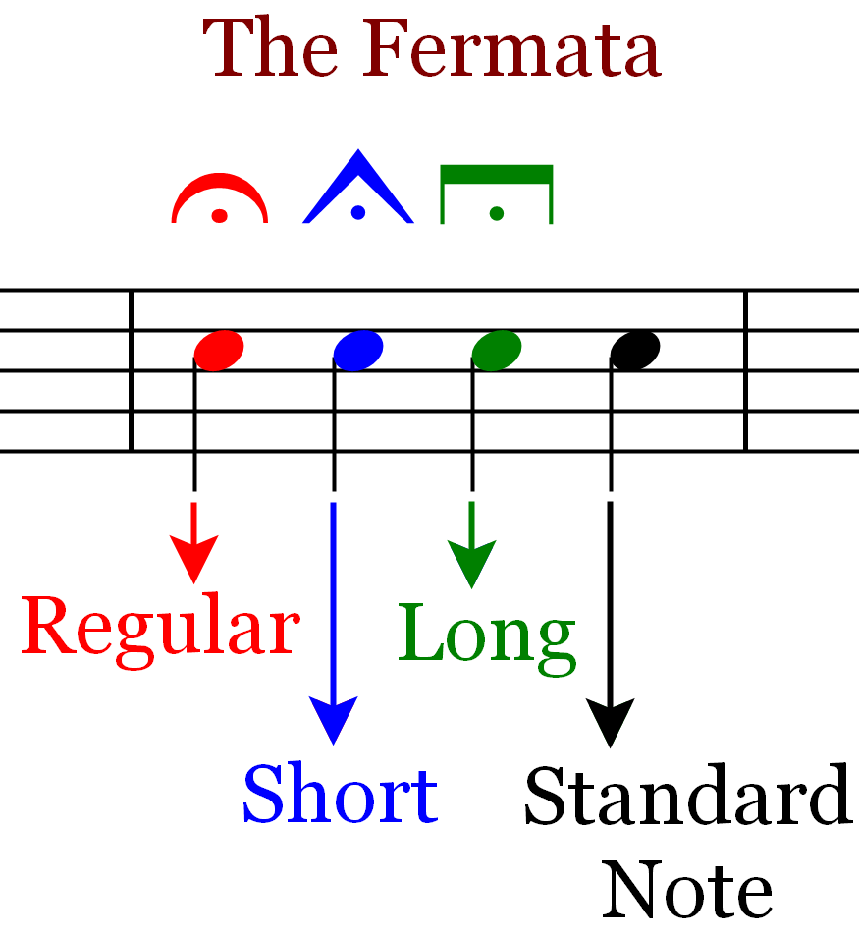
fermata
a definite but brief pause on a note (also called a bird’s eye)
Advanced Study at:
http://donrathjr.com/fermata-music-theory/

Slide 29
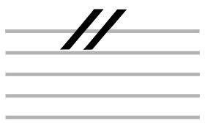
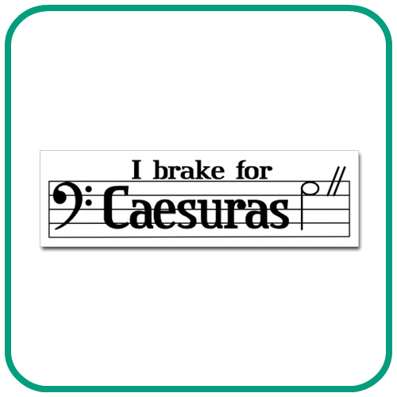
caesura
Notation: Railroad tracks
In musical notation, caesura denotes a complete cessation of musical time

Slide 30
The End
Practice following your conductor’s beat and tapping your foot
For ADVANCED STUDY: http://en.wikipedia.org/wiki/Tempo has
More information

