Slide 1
Lines and Spaces
The Musical Alphabet on the Staff

Slide 2
Direction
Notes go UP, DOWN, or STAY THE SAME on the STAFF

Slide 3
What is the staff?
FIVE parallel lines on which ovals are placed
Think of it as a ladder with rungs – each rung is a pitch

Slide 4
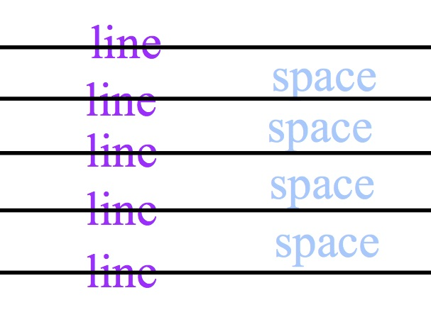
Staff Lines/Spaces

Slide 5
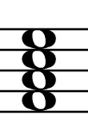
Staff Lines/Spaces
Line Notes
Space Notes

Slide 6
THE Music Alphabet
ABCDEFGABCDEFG
These letters repeat over and over to name the pitches of notes in music

Slide 7
Can you say it?
Say the alphabet forward
Say the alphabet backward

Slide 8
THE Music Alphabet
Each letter represents a definite pitch or frequency – a sound
If it’s round it makes __

Slide 9
THE Music Alphabet
The LETTER names on the staff NEVER CHANGE.
Scale degrees and Solfege change from song to song!

Slide 10
Direction
As notes go up the staff, each line and space moves forward one letter in the alphabet

Slide 11
Direction
As notes go down the staff, each line and space moves backward one letter in the alphabet

Slide 12
Lines and Spaces
Ovals (notes) through which a line passes horizontally are called LINE NOTES

Slide 13
Lines and Spaces
Ovals (notes) which lie next to lines are called SPACE NOTES

Slide 14
Treble Clef Lines NOTES
Fly
Does
Bird
Good
Every

Slide 15
Treble Clef SPACE NOTES
E
C
A
F

Slide 17
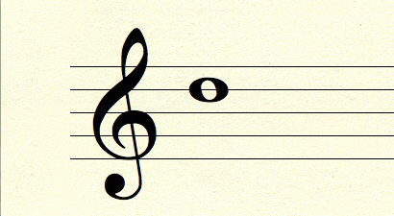

Slide 18
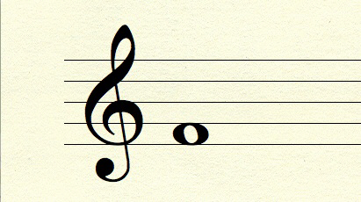

Slide 19
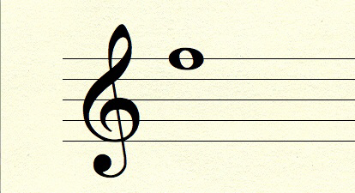

Slide 20
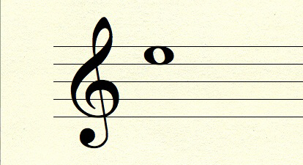

Slide 21
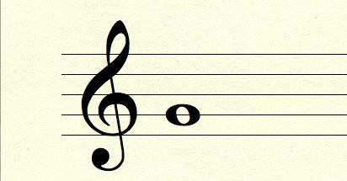

Slide 22
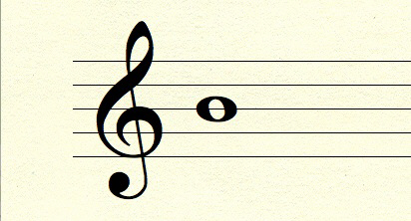

Slide 24
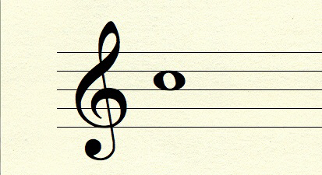

Slide 25
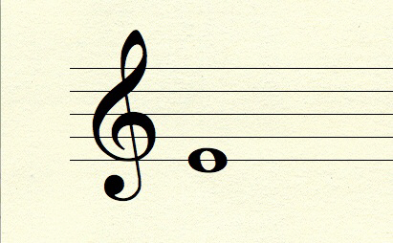

Slide 26
Bass Clef Lines NOTES
Animals
Fight
Dogs
Big
Great

Slide 27
Bass Clef SPACE NOTES
Grass
Eat
Cows
All

Slide 28
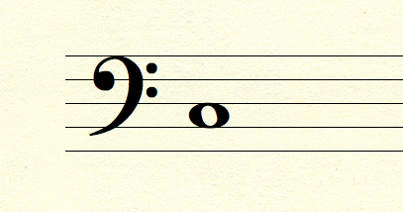

Slide 29
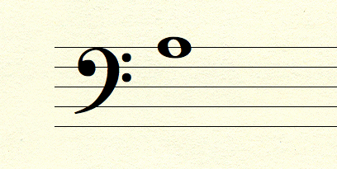

Slide 30
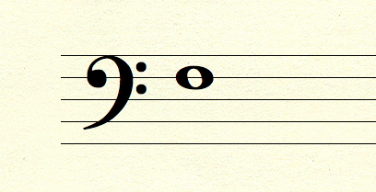

Slide 31
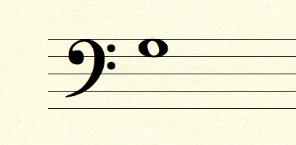

Slide 32
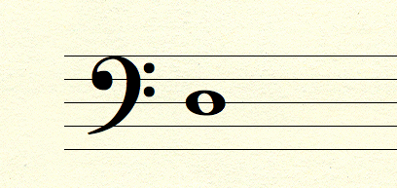

Slide 33
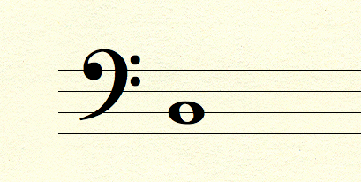

Slide 34
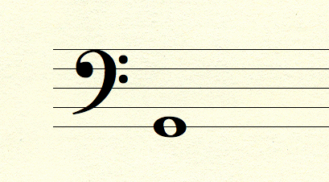

Slide 35
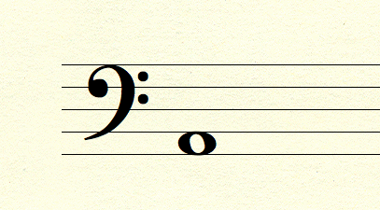

Slide 36
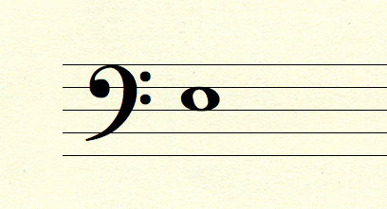

Slide 37
MEMORIZE
Memorize the position of all treble and bass clef notes on the staff
Practice naming them

